Slide 1
Strategic Planning:
A Bright Idea!

Slide 2
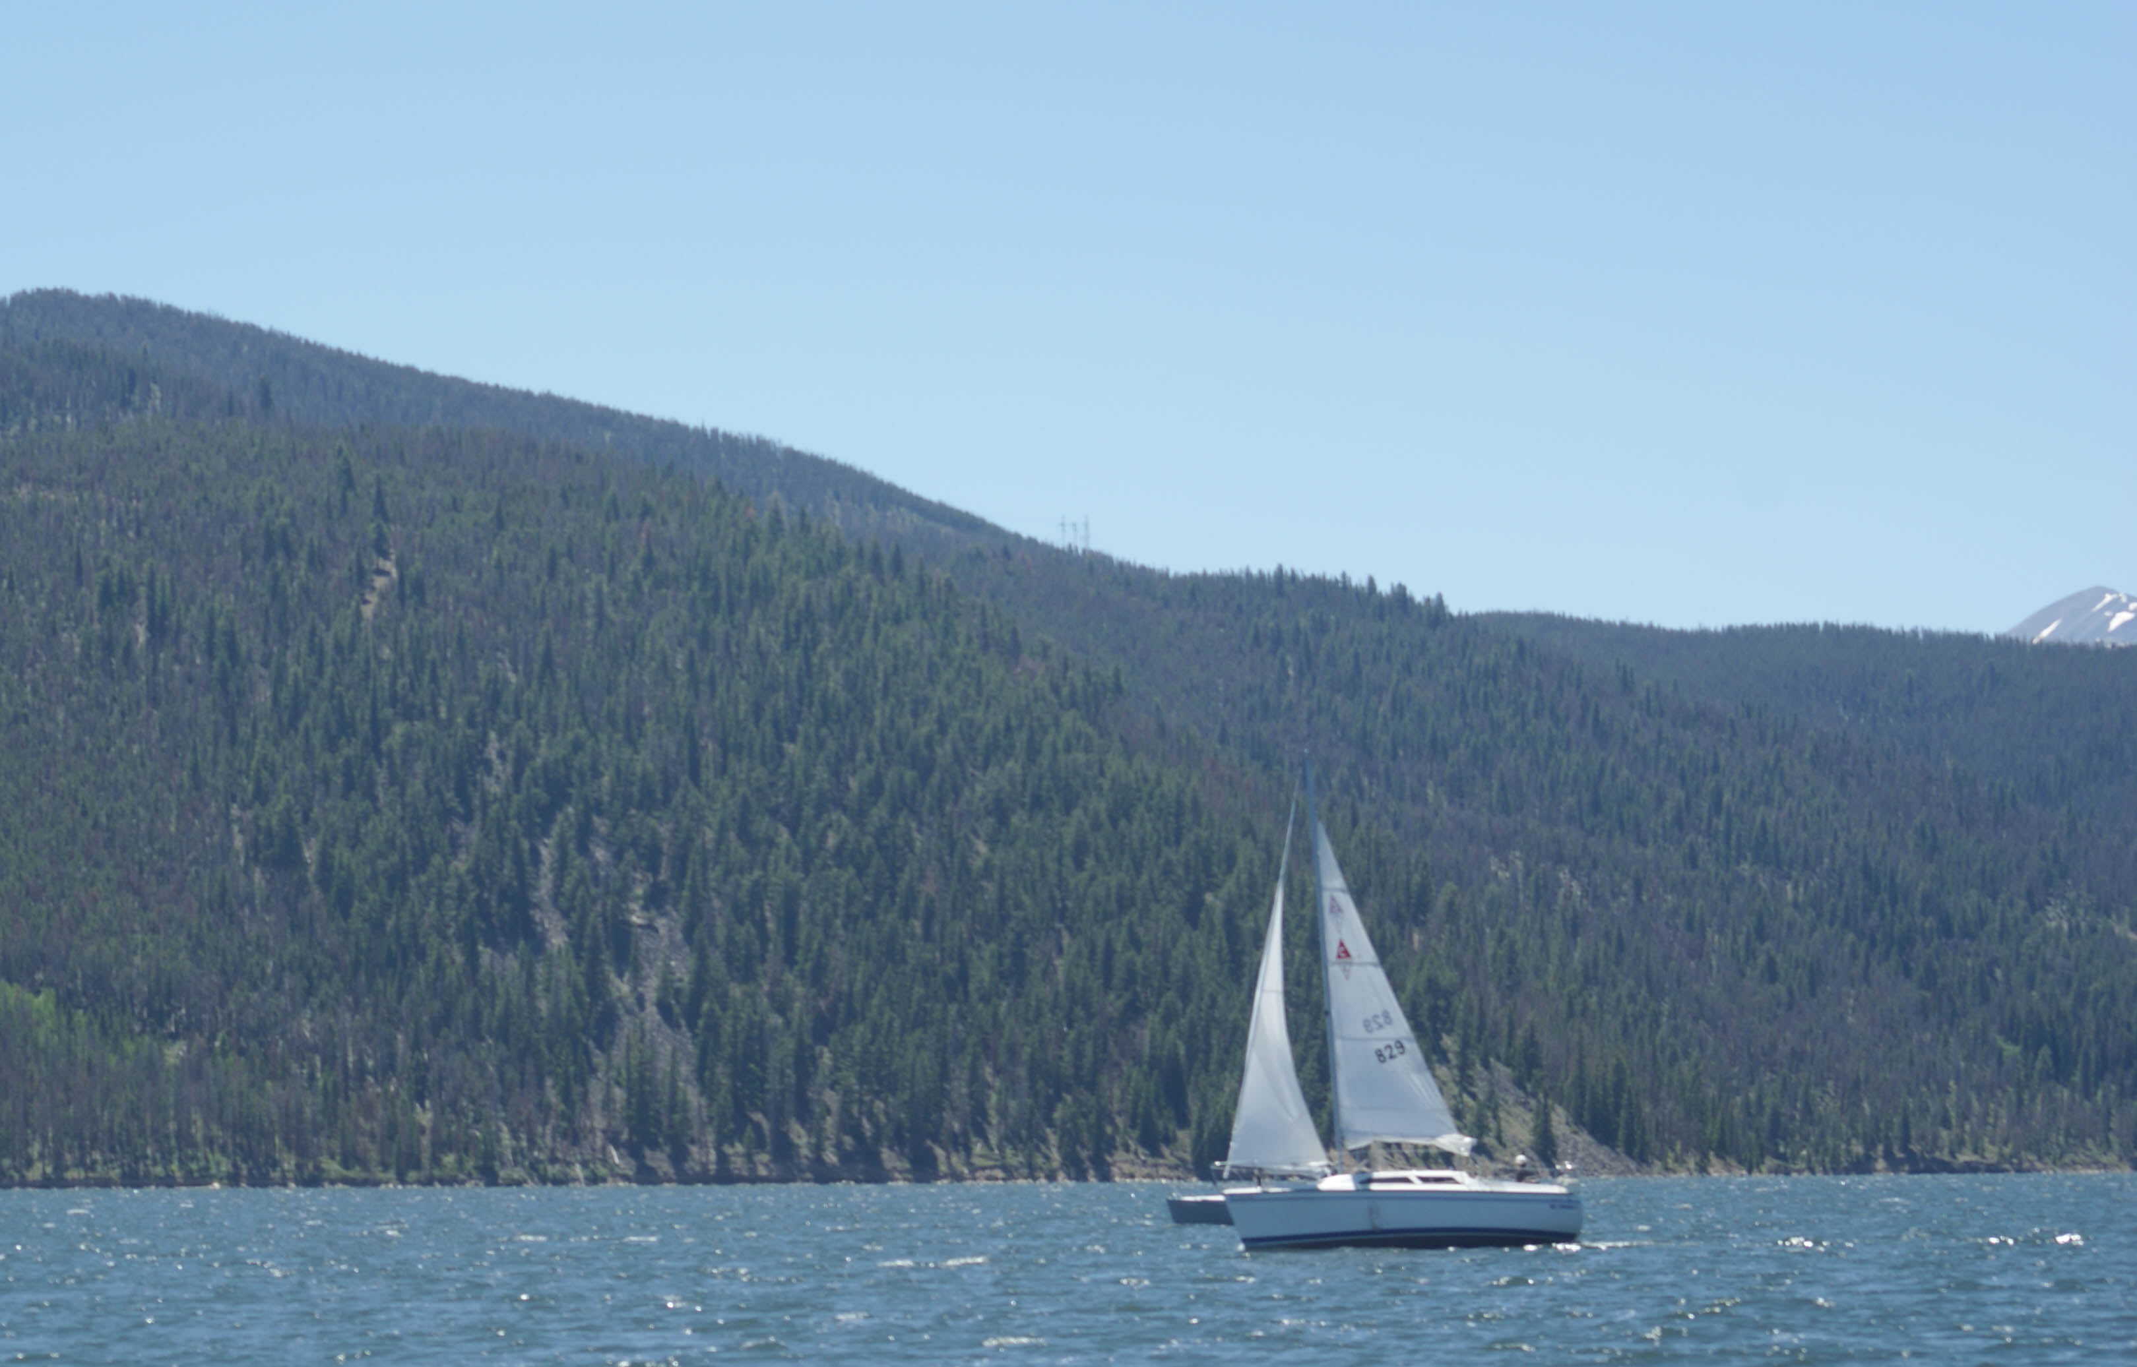
Why plan?
Without goals and plans to reach them, you are like a ship that has set sail without winds or a destination

Slide 3
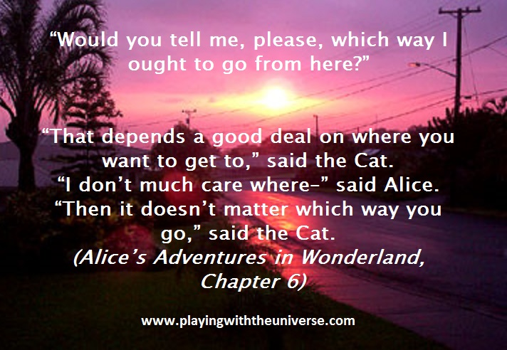

Slide 4

Always Plan Ahead
It wasn’t raining when Noah built the ark

Slide 5
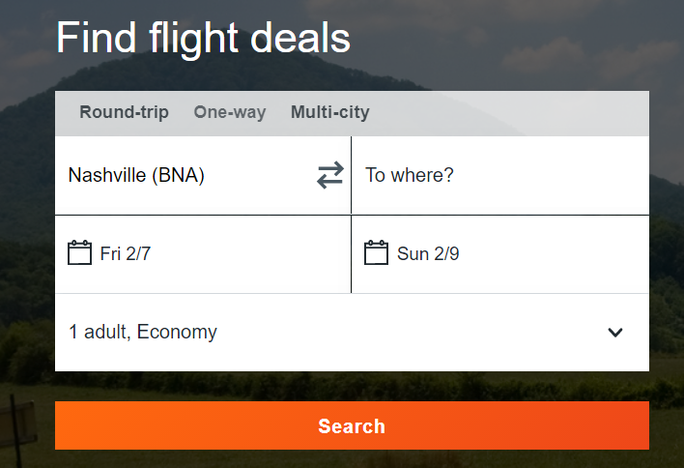
First you start – Where are you?

Slide 6
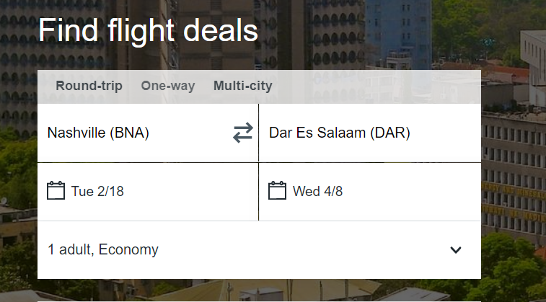
Where do you want to go?

Slide 7
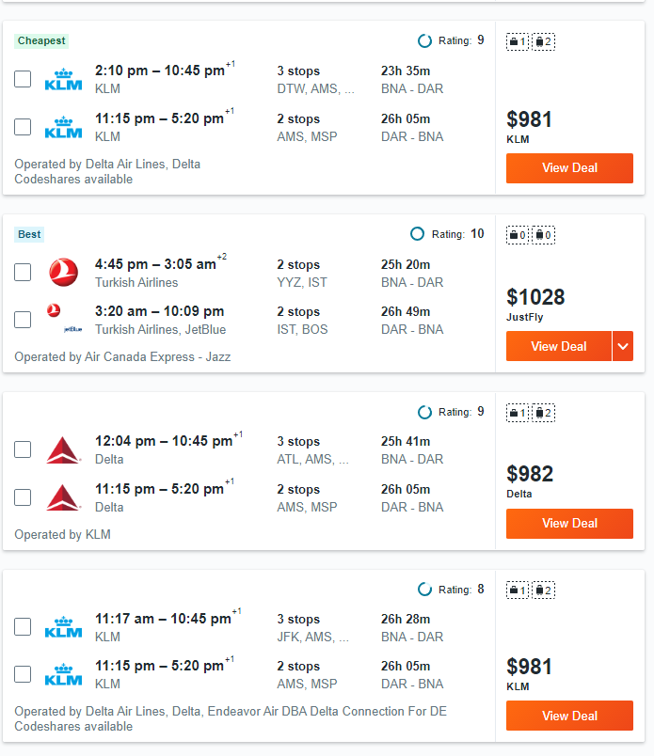
Then, How do We get there?

Slide 8
The Planning Cycle
Environmental
Scan
Visioning
Action
Plan
Implmentation
Evaluation

Slide 9
Environmental Scan
Consists of two parts
  Internal Conditions
  External Impact
Leave no stone unturned!
  What is your Tourism Infrastructure
  Marketing
  Staffing
  Visitors Profiles

Slide 10
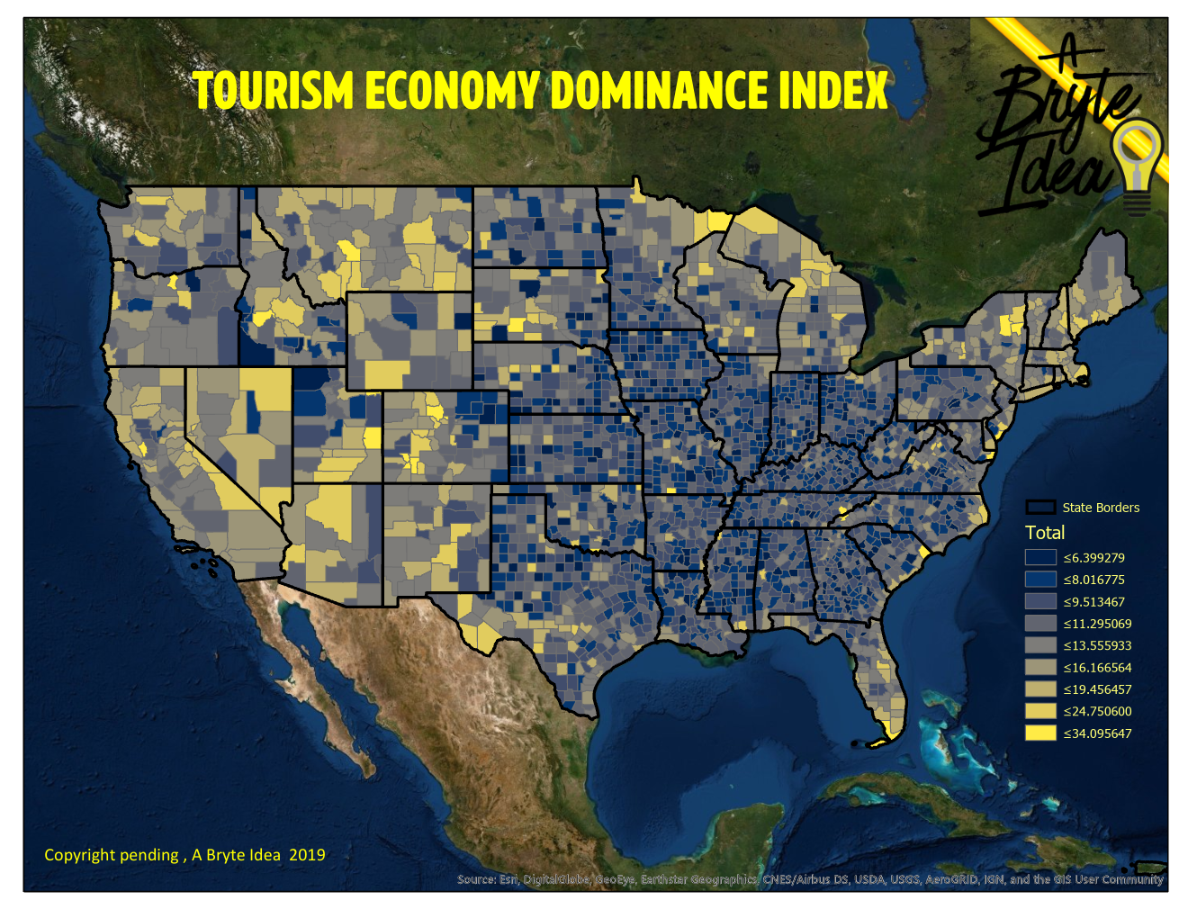

Slide 11
HAVE’s
Hooks
Assets (Natural)
Venues
Entertainment/Events

Slide 12
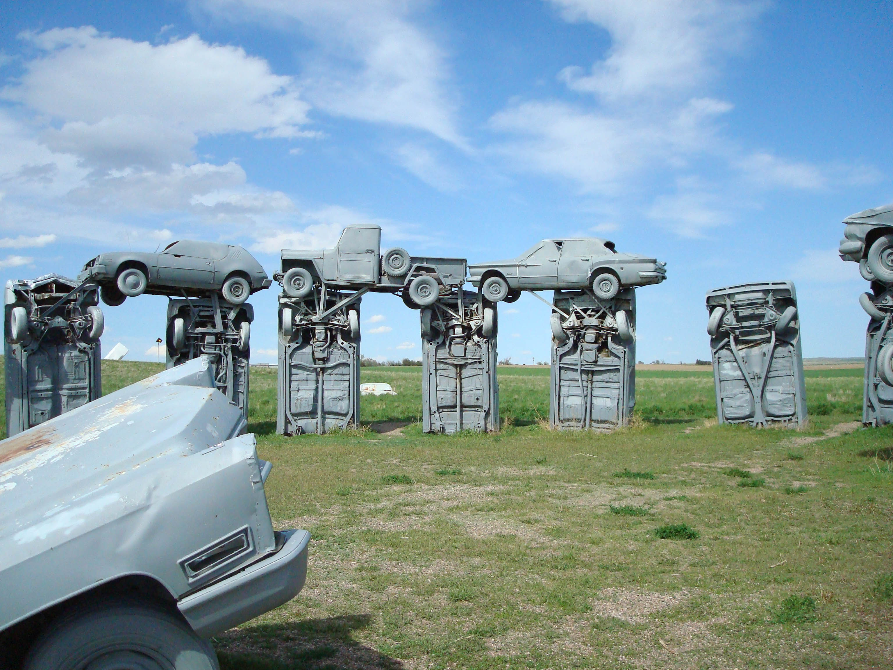
HOOKS
A usually free attraction that causes visitors to come to the community to spend some time, however limited, to see the attraction.

Slide 13
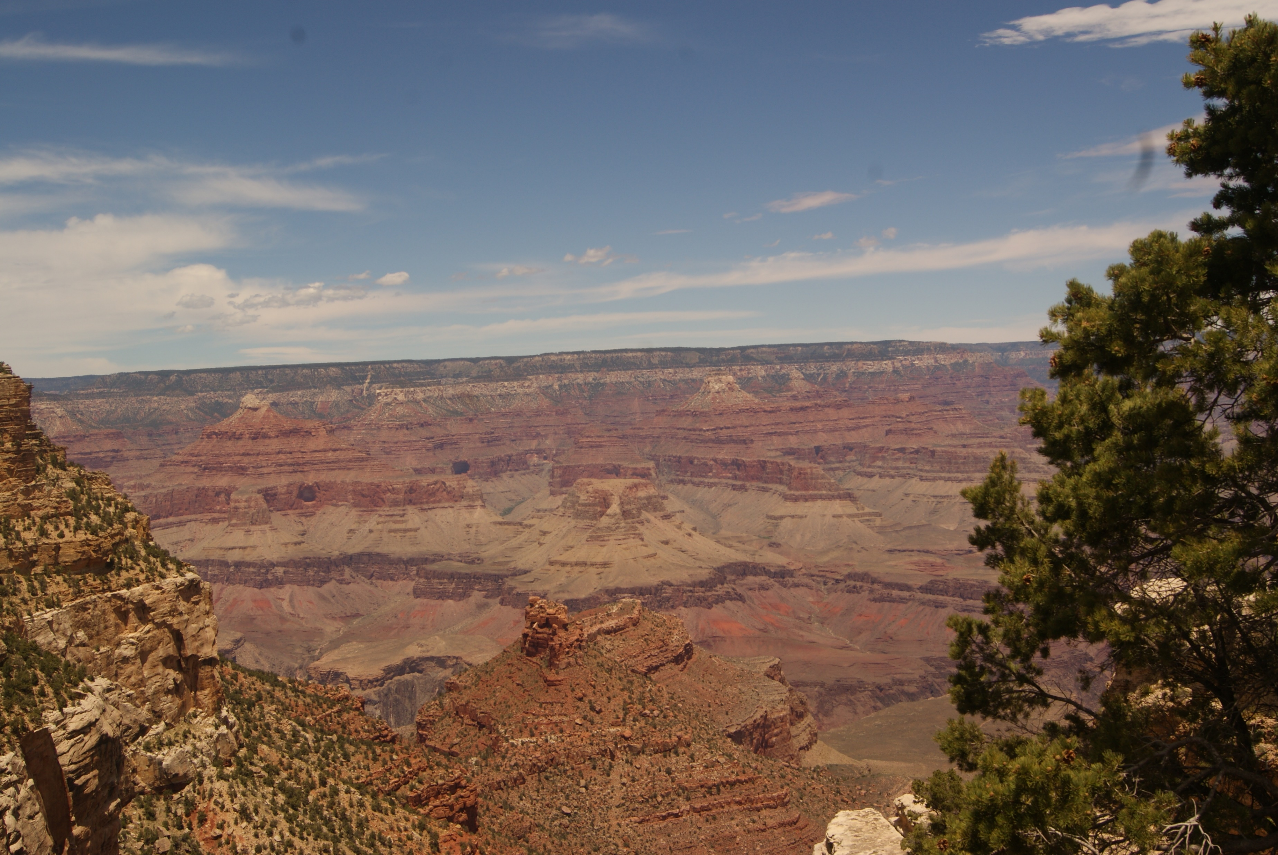
Assets (Natural)
Natural Beauty that attracts people to visit the area
Mountains
Beaches
Geological Land Forms
Waterfalls

Slide 14
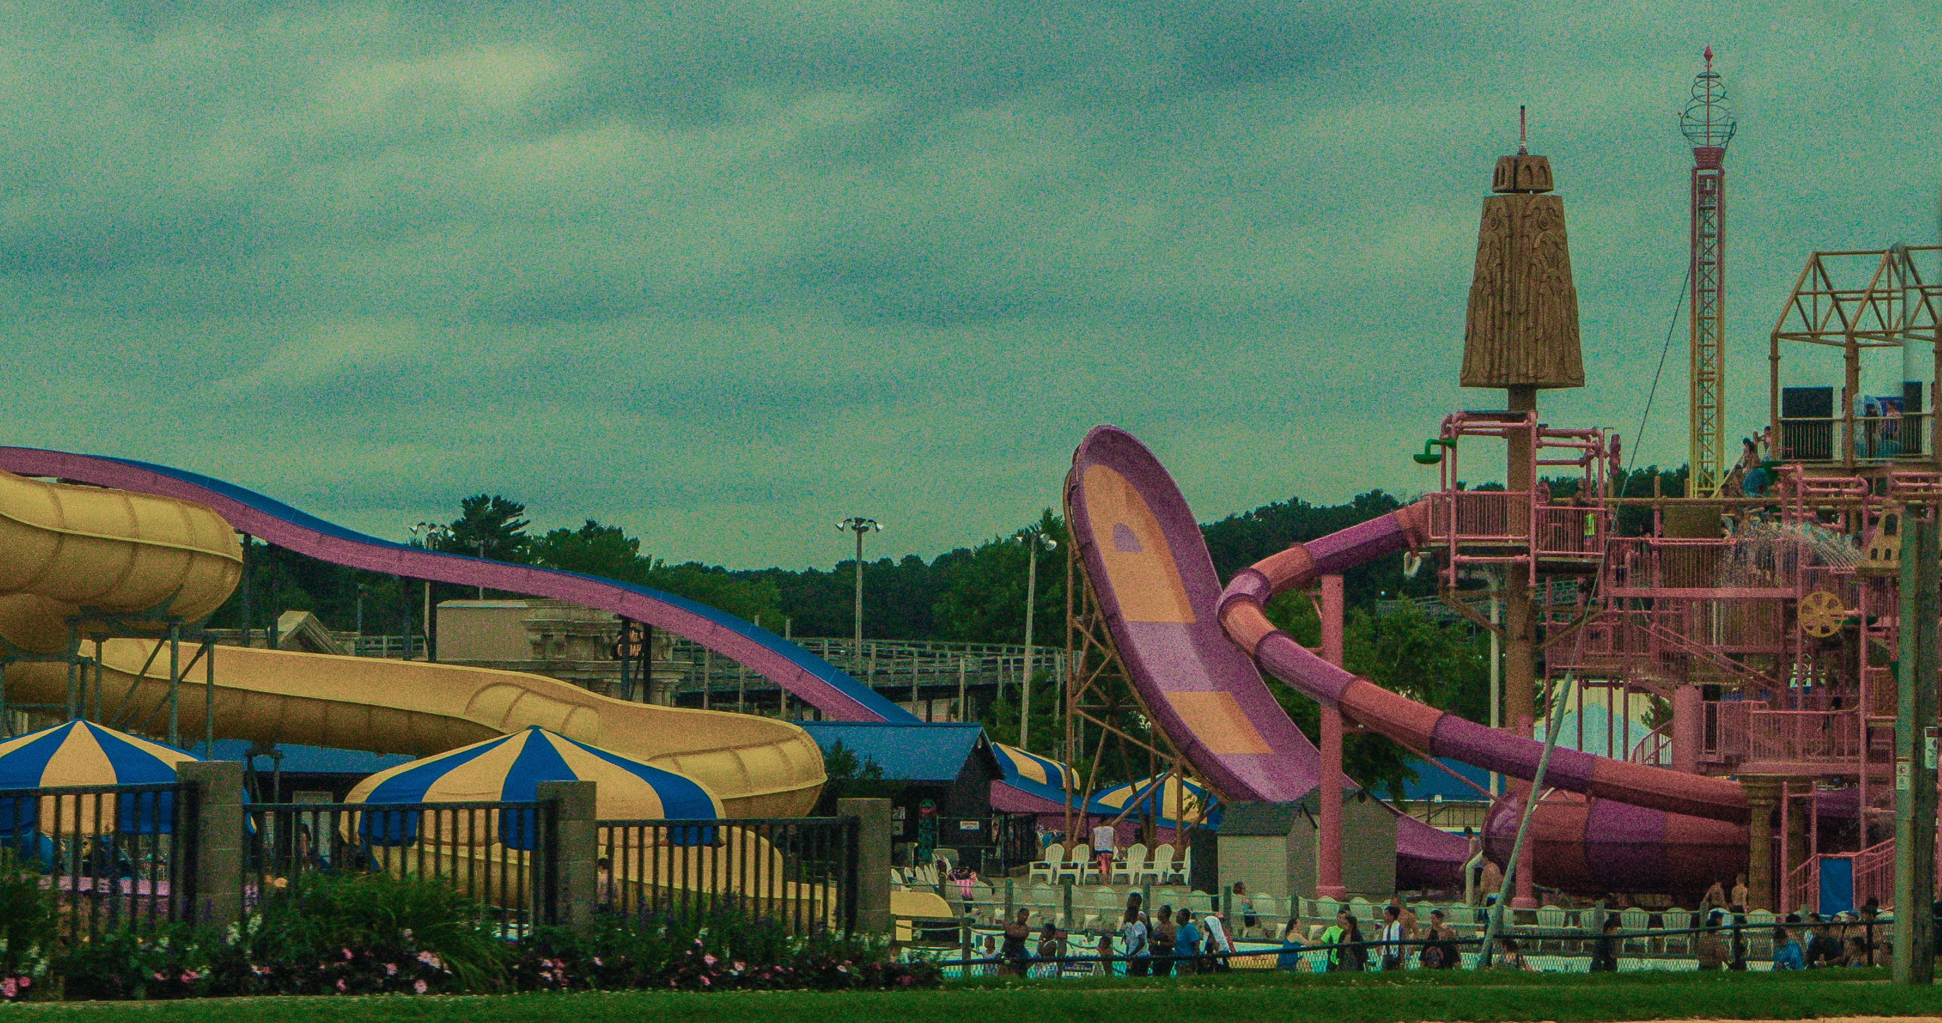
Venues
An attraction that encourages visitors to spend a significant portion of the day at a price that generally is not an unbudgeted expense for most families.
Amusement or Water Parks
Casino Hotels
Ski Parks
Marinas
Golf Courses (More than 5 courses)

Slide 15
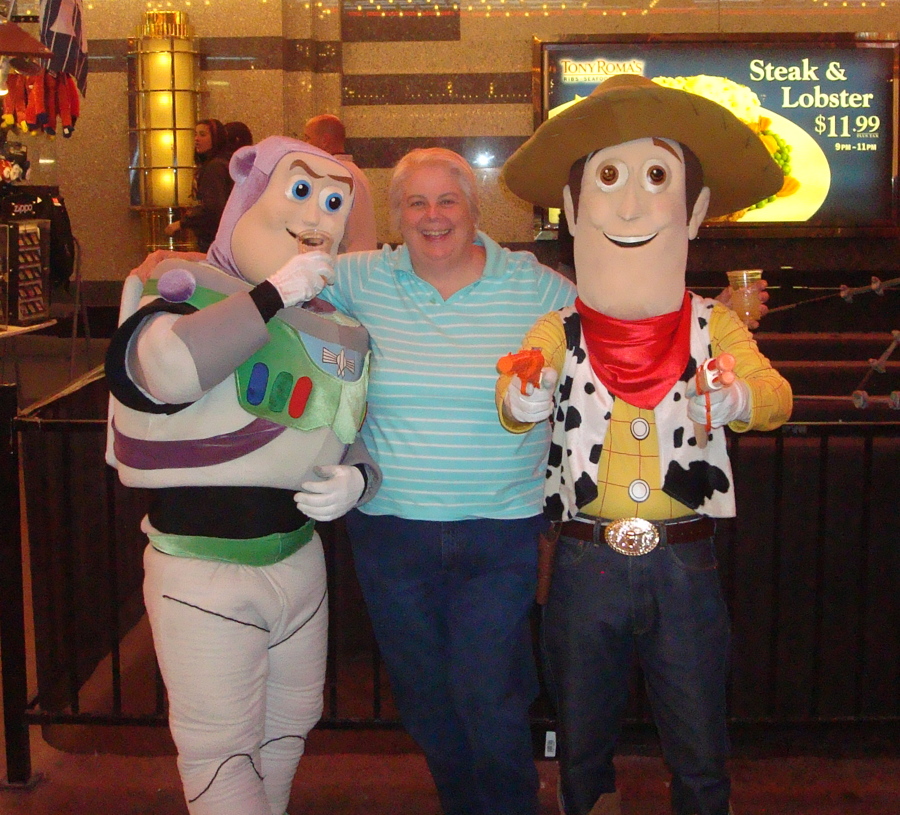
Entertainment/EVENTS
Entertainment venues which do not charge an admission fee but provide entertainment in an area which may also provide other activities such as amusements, eateries, or retail. Events are scheduled for a specific date and place.
Musicians playing in a retail area
Street performers
Light displays

Slide 16
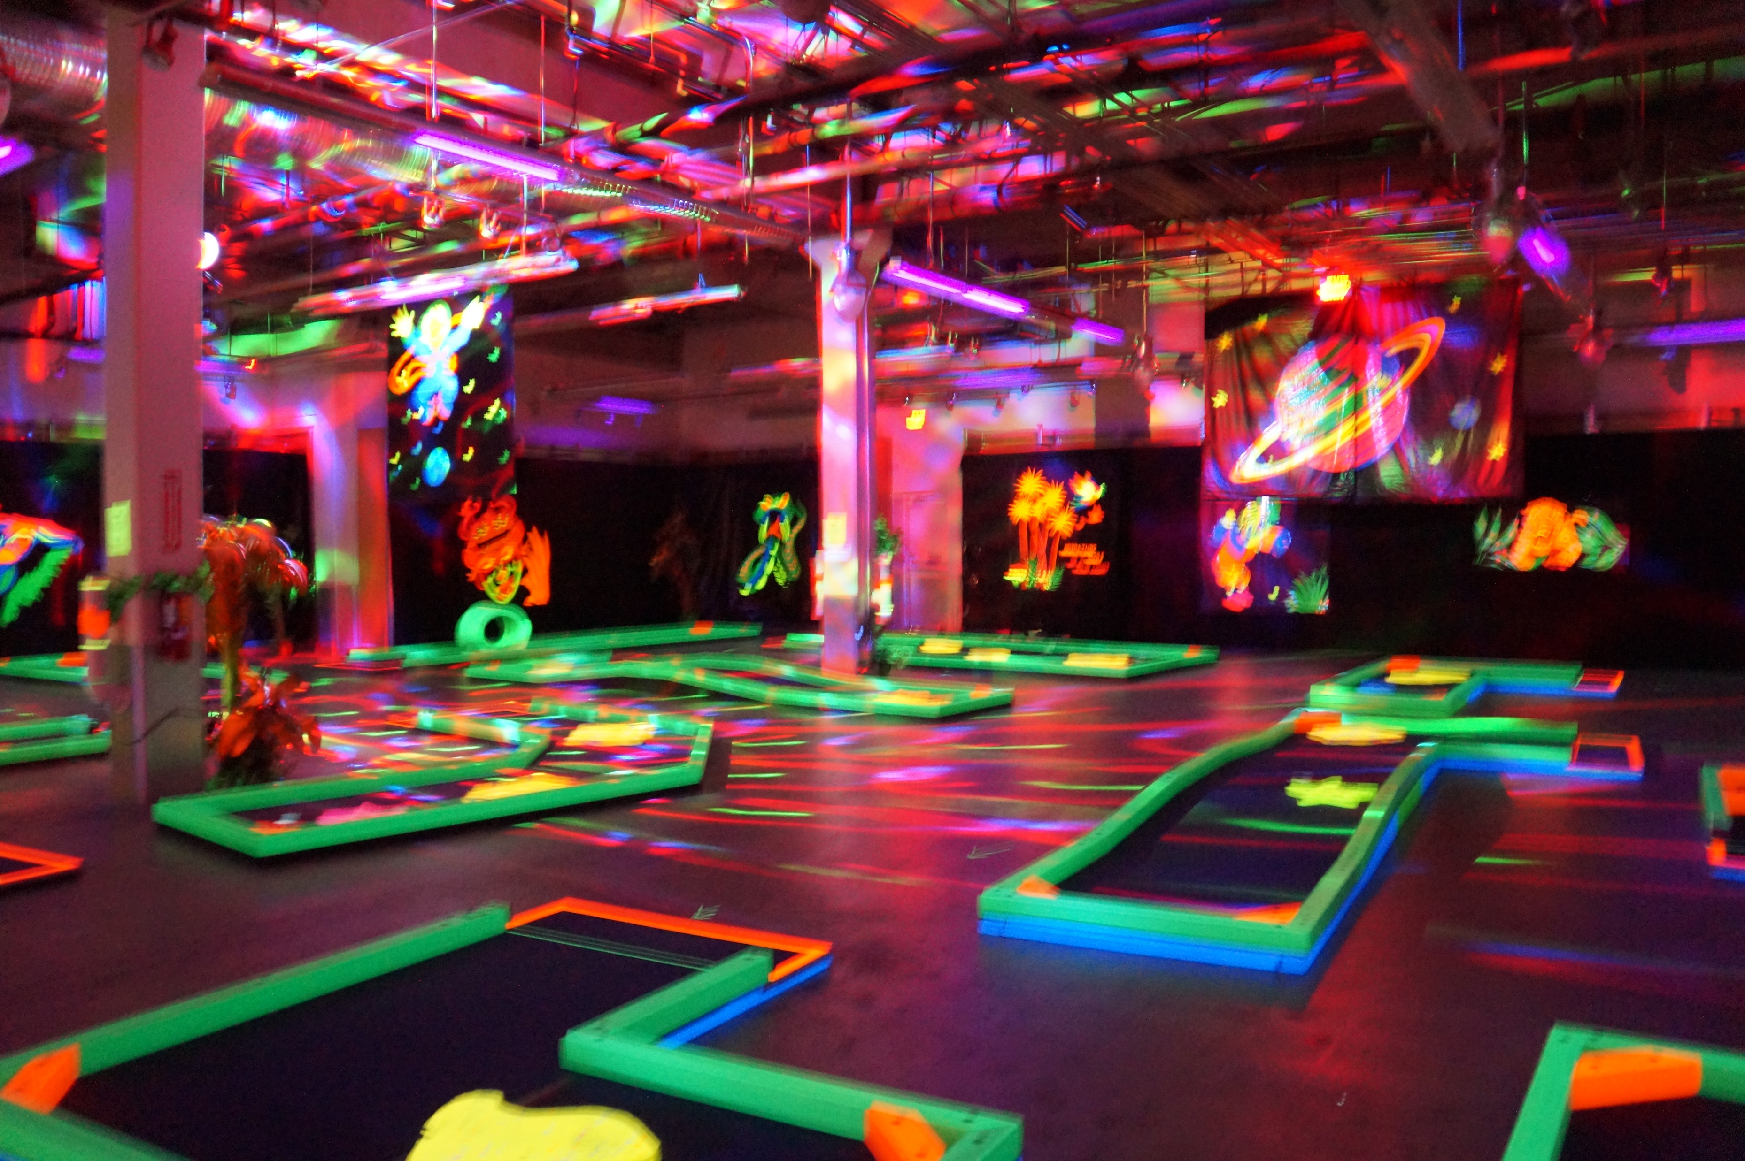
After they are there, you need:
Something else to keep them busy
Some place for them to stay
Some place for them to eat
OF COURSE, Some Place for them to shop!
The more you have for them to do, the longer they stay! The longer they stay, the more money they spend in your community as opposed to someone else's.

Slide 17
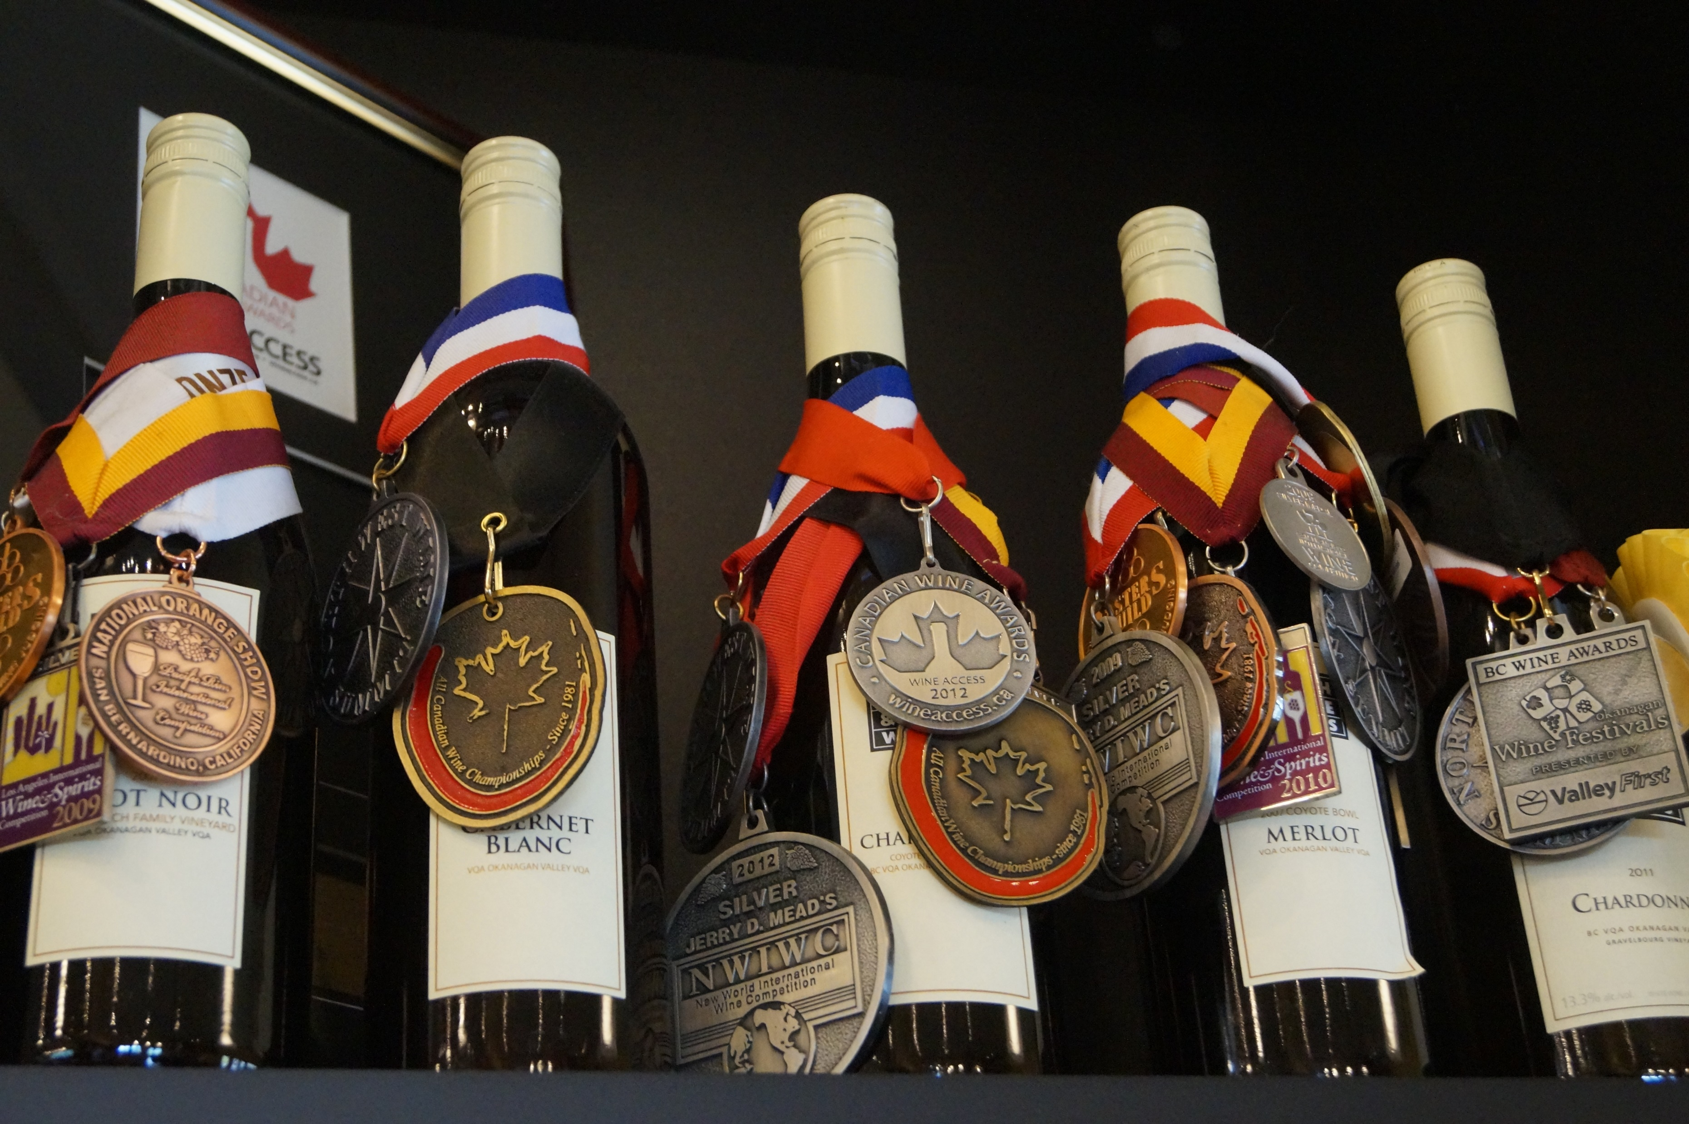
Attractions
Wineries, Cideries
Museums, Zoos, Historical Sites
Arcades, Casinos (Not Hotels)
Sporting Venues
Performing Arts Venues, Theater and Dance Companies
Attractions, not counted somewhere else
Site Seeing Transportation

Slide 18
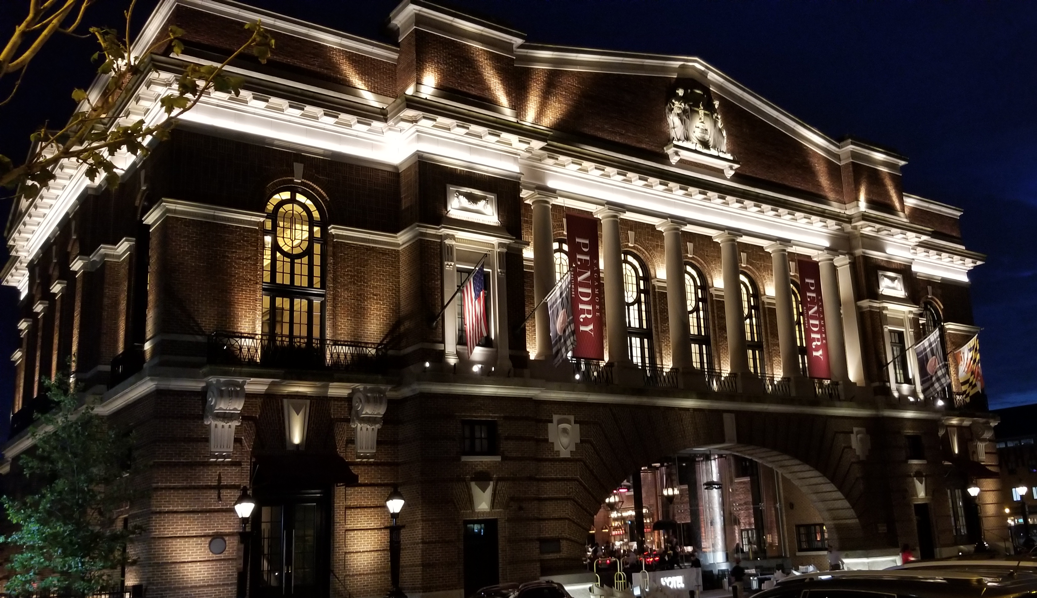
Accommodations
Hotels
Bed & Breakfasts
Timeshare
Campgrounds
Air BnB’s
Family Lodging

Slide 19
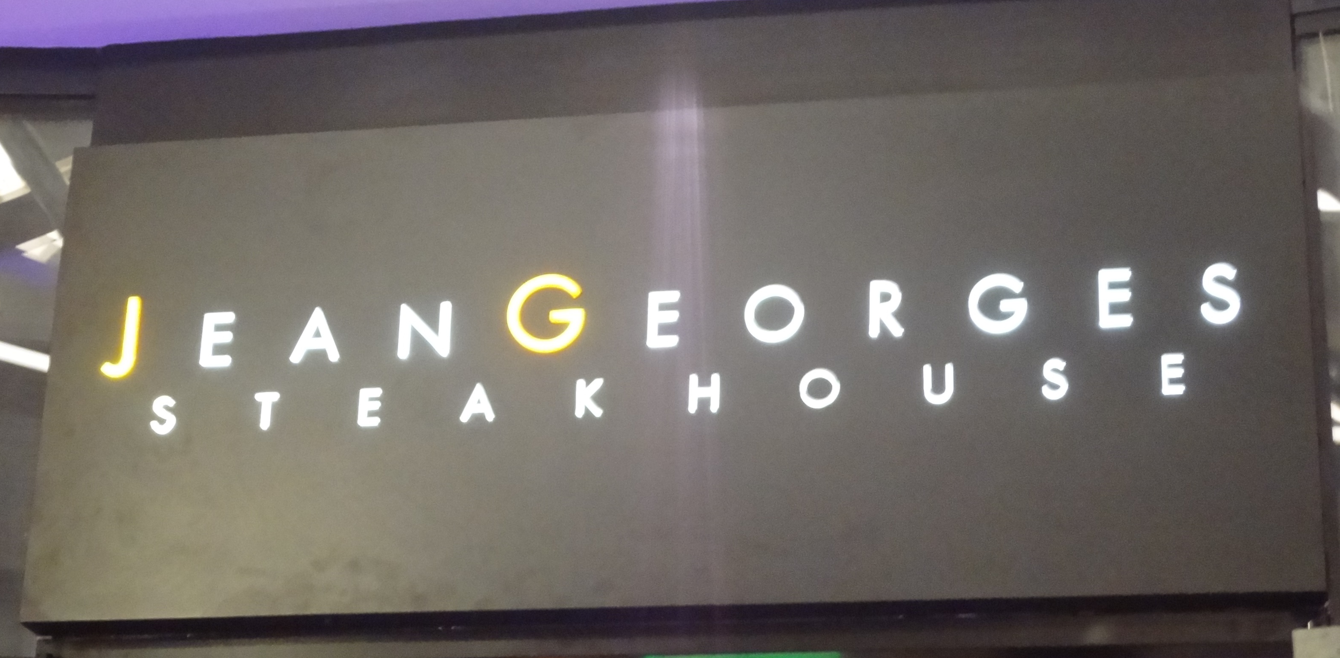
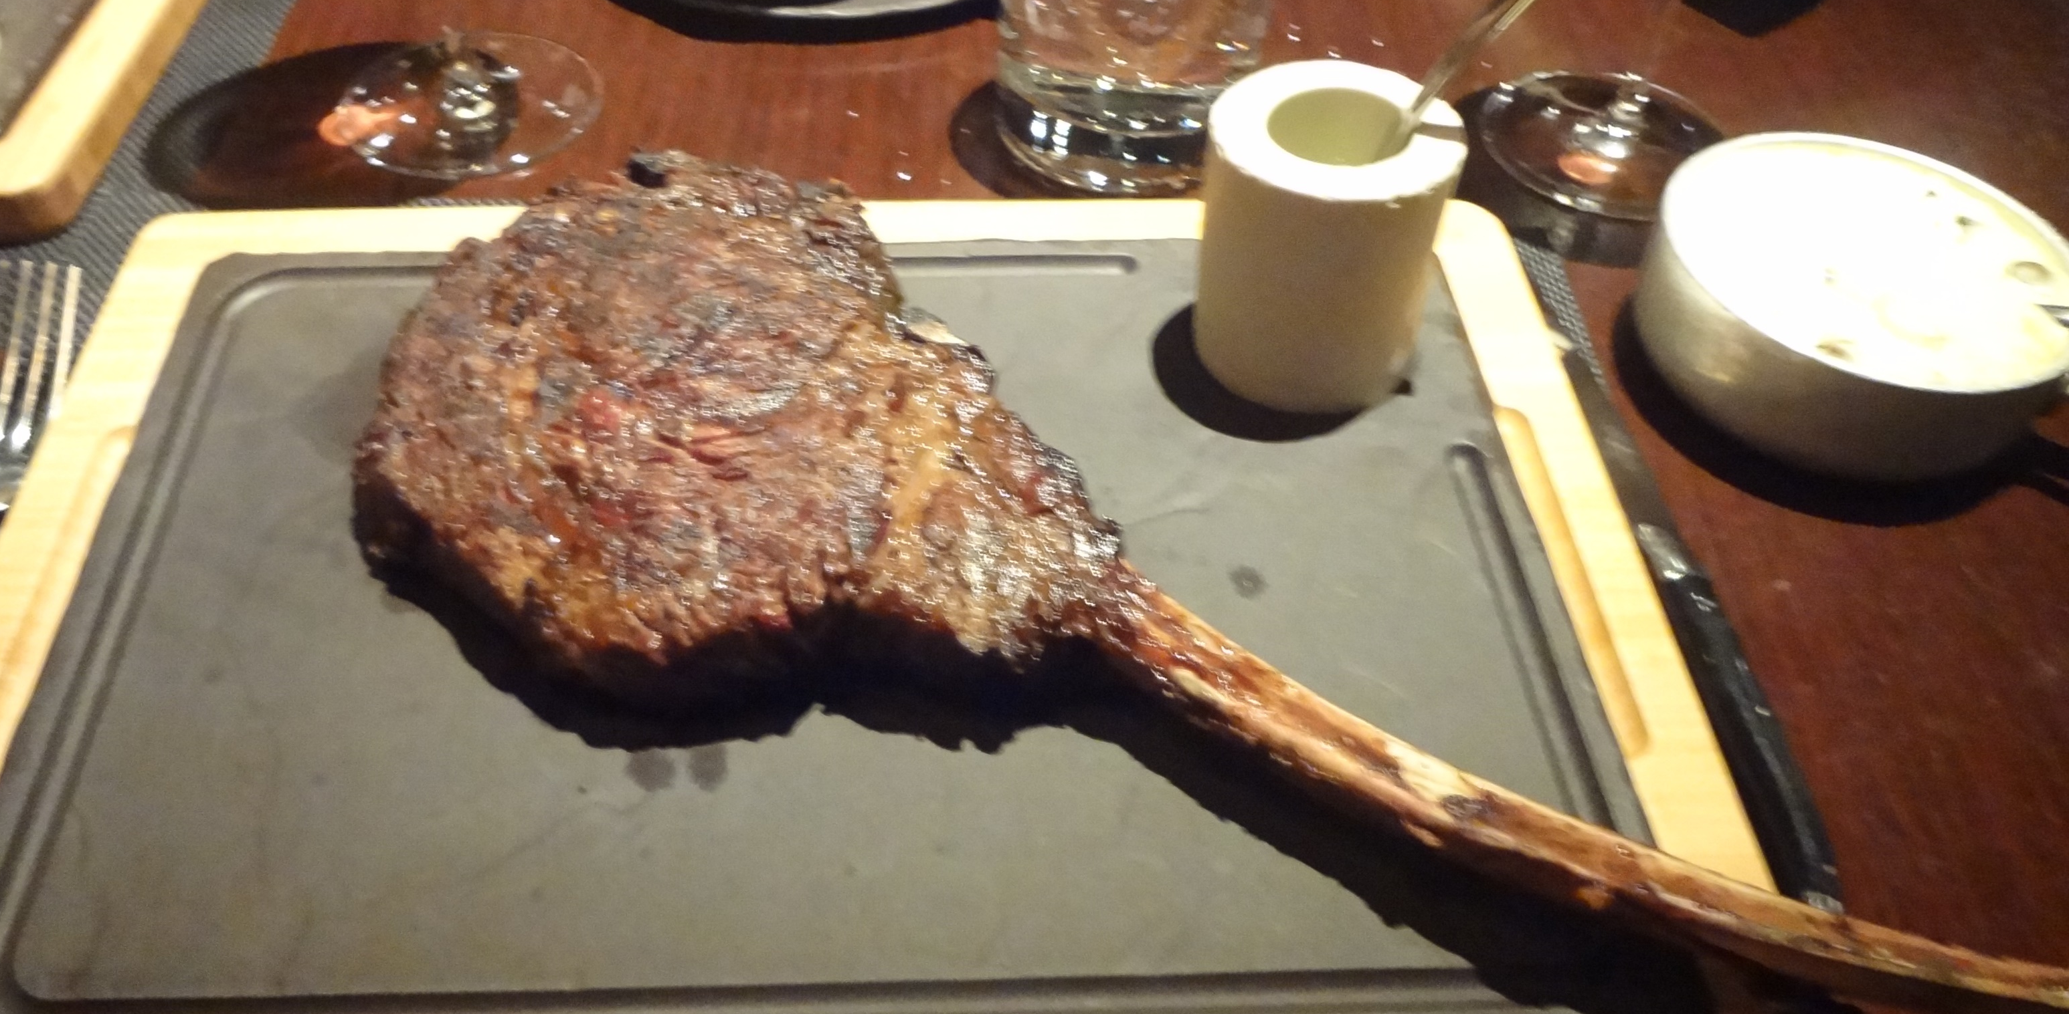
Eateries
Full-Service Restaurants
Limited Service Restaurants
Cafeteria and Buffets
Snacks and Non-Alcoholic Beverage Bars
Breweries
Food Trucks

Slide 20
Take Stock
What do you have?
What do you need?
What could be improved?
How do things look?
Are you taking care of your visitor?

Slide 21
And Don’t forget
How are you doing on marketing?
Do you have the leadership you need to accomplish things?
How is your financial position?
Do you have the political support you need?

Slide 22

Looking outside your organization
“If does not do to leave a live dragon out of your calculations if you live near one. “
-J.R.R. Tolkien

Slide 23
PESTLE
External Impacts
Factors that come at you from outside your organization that can impact – positively or negatively your accomplishment of your goals. They can also influence what your goals are and how they may change.
Political
Economic
Social
Technological
Legal
Environmental

Slide 24
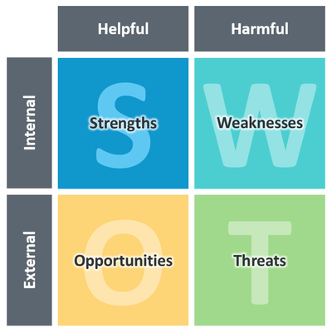
SWOT

Slide 25
VISIONING
Stated as a positive in current tense, not future tense
Use action verbs and plenty of adjectives
Our downtown is an inviting, pedestrian friendly dining, entertaining, and shopping environment that invites locals and visitors alike, to spend their time and money while enjoying friends and family and creating lifelong memories.

Slide 26
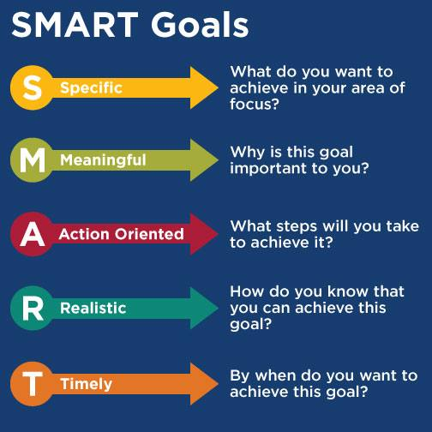

Slide 27
ACTION PLANS
Each vision should have a series of action plans that when accomplished will ensure the achievement of the desire vision
The action plan steps should identify the responsible party, what the expected deliverable will be, and time frame for accomplishment.
If you can’t get from start to finish – get started!
Action Plans should be revisited annually to move the goals forward.

Slide 28
Put it all together!
It doesn’t matter how pretty or neat it is
Number of pages does not count!
What matters is that the members of the organization is behind the plan 100%
They are willing to do the hard work of making it happen!
.

Slide 29
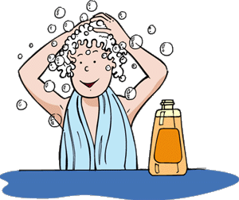
Wash, Rinse, Repeat!
Do quarterly assessments of where you are on your action plans
Do annual assessments to esure you are on the right path
Every 3 -4 years, start all over again.

Slide 30
Raise your hand!
I promise to ban the words to die by:
words to die by:
We’ve always done it this way
We tried that once
We did a plan 10 years ago, we haven’t accomplished those things yet, why do it again?
We are too busy doing to plan

Slide 31
Ways to get started
Goal Setting Session
  Organizationally oriented for the next couple of years
  Not as deep and doesn’t take as long as other choices
Strategic Plan
  Time frame of the next 5 – 10 years
  Much broader involvement with more input and involvement
Long Range Strategic Plan
  Time from is often as long as 20 years
  Process is similar to the strategic plan
  Usually includes more technical consulting – such as marketing or wayfinding as a part of the planning process.

Slide 32
IF not now, When?
Hillel the Elder

